Slide 1
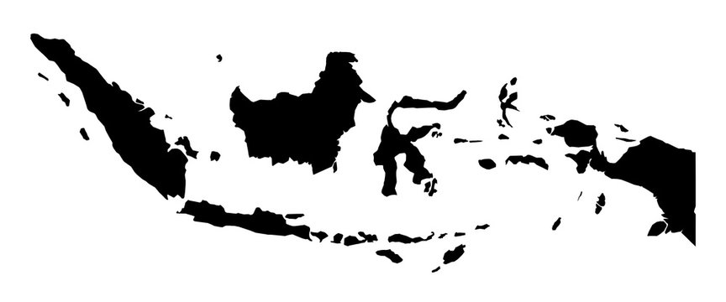

Tambora Today Ashfall and impacts of the 1815 eruption on modern Indonesia
Alexander Vitantzakis & Jonathan Schulte
10.02.2026
Computational Earth System Sciences
Nico Wunderling, Florian Jehn, Niki Lohmann

Slide 2
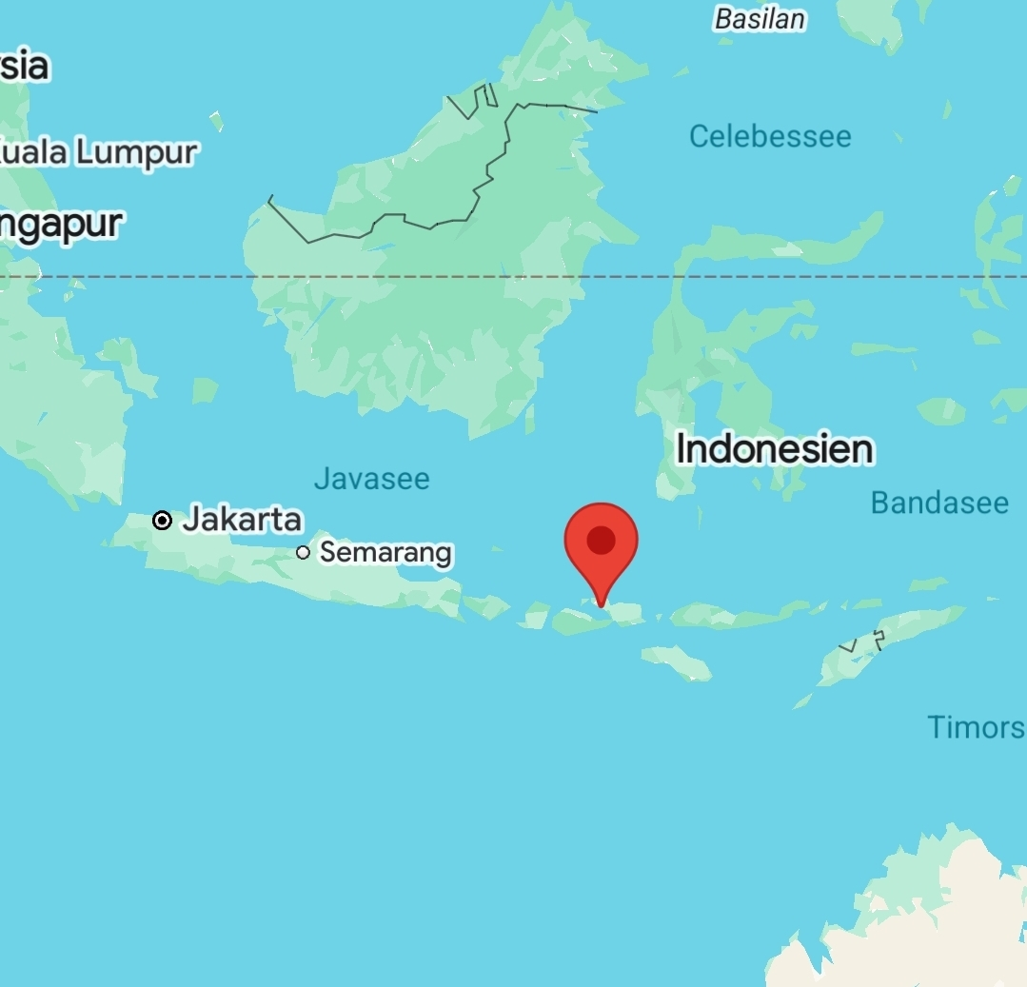
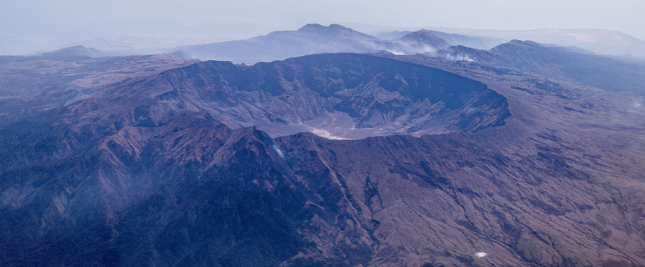
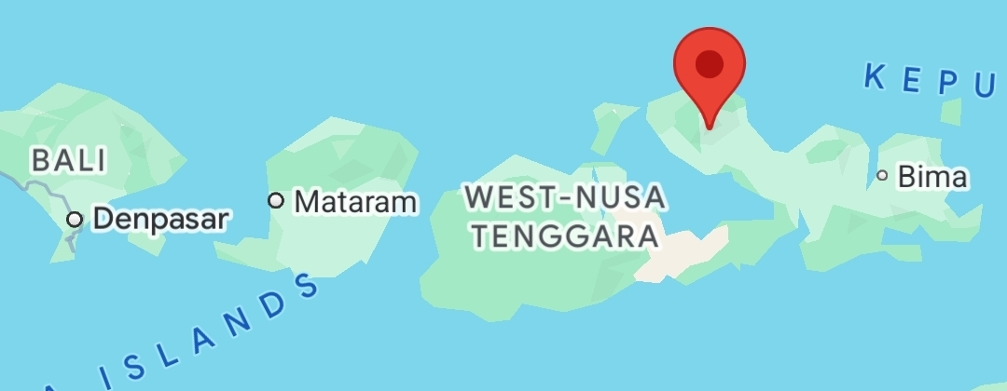
Historic Tambora
Gunung Tambora on Sumbawa, Indonesia
Two-week long mega Eruption in 1815
Total casualties 100K and unknown economic damage
taken from book [III] – ISBN: 978-3-905835-45-8
Screenshots taken from https://www.google.com/maps
Notes:
Year Without a Summer (1816) — coldest year since instrumental records began
Caldera ~6–7 km wide and >1 km deep
~150 km³ of volcanic ash ejected
~200 megatons of sulfur aerosols injected into the atmosphere
Volcano still active, but currently not considered highly hazardous

Slide 3
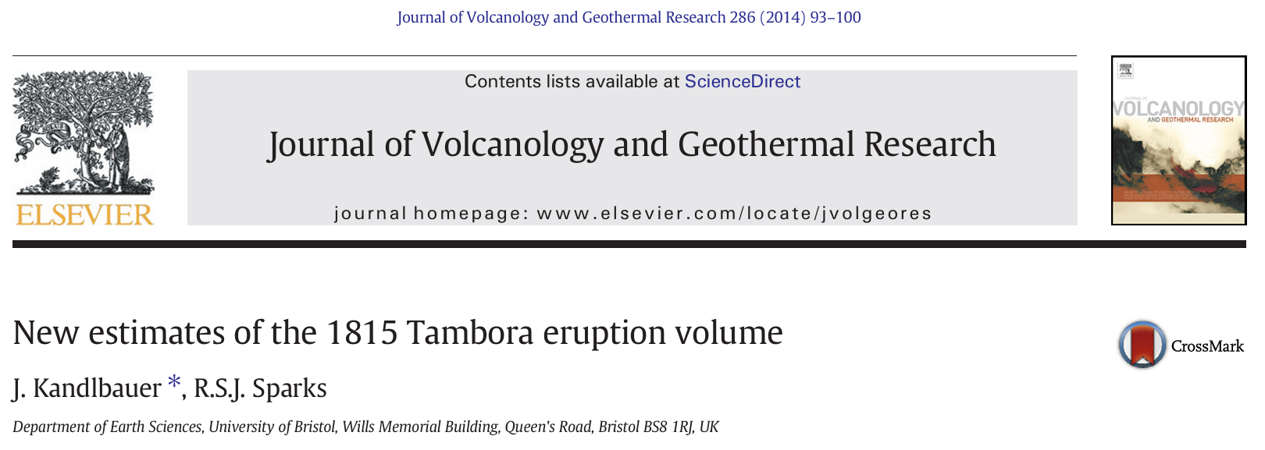
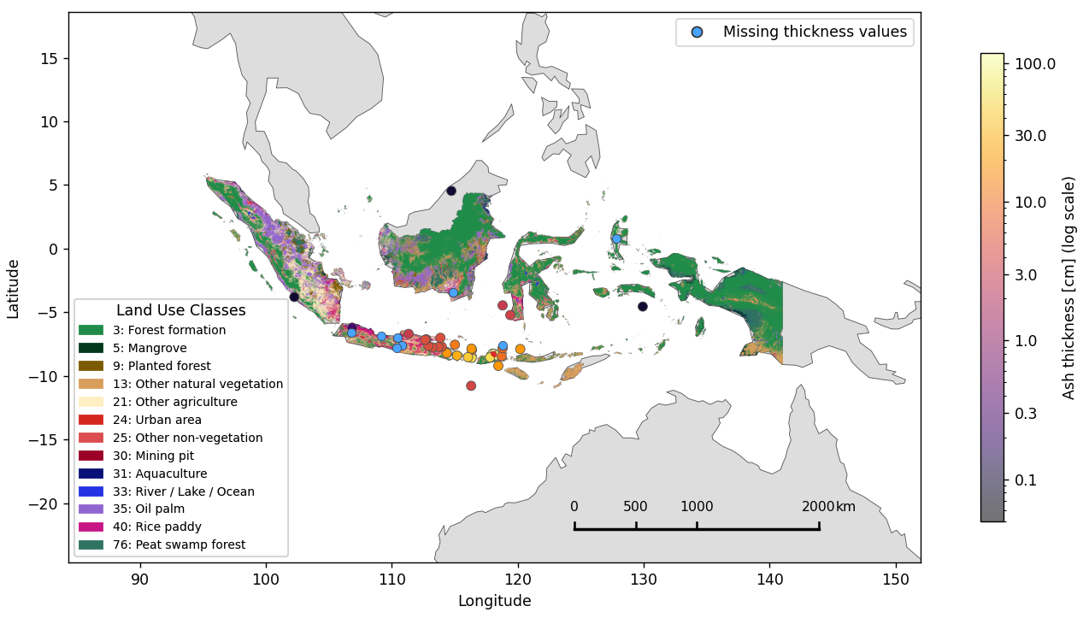
The Dataset & Basis of our Project
Epicentre Tambora
→ Publication contains all data points of the ash-fall from first-hand sources, e.g. East India Company reports, pseudo first-hand sources like deep sea cores and second-hand sources
3
J.Kandlbauer, R.S.J.Sparks; Journal of Volcanology and Geothermal Research, 286 (2014) 93–100
Notes:
Left side
Paper by Kandlbauer & Sparks (2014)
Includes volume calculations
Highlights how uncertain the data situation is
Error bars of about ±25%
Data points originate from multiple sources — both historical and modern (1816–2013)
New data points were obtained through recent simulations
Includes both deep-sea and terrestrial deposits
Critical parameters include eruption timing and particle fall velocity
Right side
Map of Indonesia and neighboring regions
Blue dots represent measurement points without specific quantitative values
Map was matched with data from Indonesia MapBiomas
Research initiative (originally from Brazil) focused on climate and environmental monitoring
Scale in the lower right provides a rough impression of the spatial extent

Slide 4
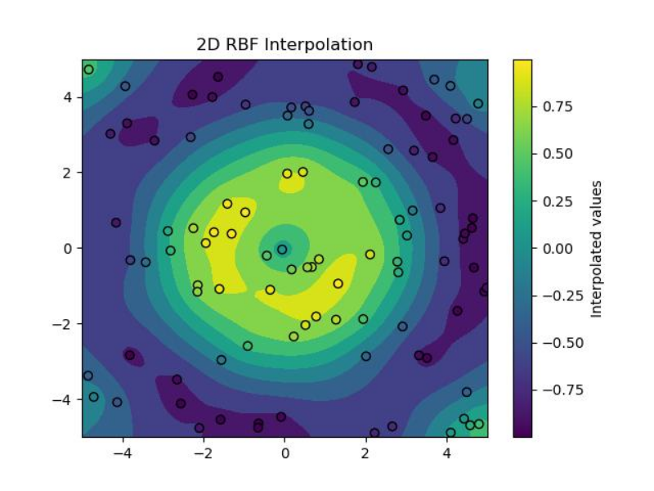
Interpolation with Python
Spatial Smoothing – RBF Interpolation
SciPy Rbf() with a linear basis function (local)
Grid resolution for agriculture: 6000 × 6000 px
41 data points, but only 30 usable (missing thickness values in cm → excluded)
Spatial data limitations:
Uneven spatial distribution of measurement points
Strong clustering around the eruption centre
Very sparse coverage toward distal regions
Particularly no measurements south of Tambora
→ solution: distance-weighted taper function
typical RBF artefacts:
Unrealistic long-range extrapolation
Artificial ash “tails”
Overestimation in poorly constrained regions
Fig 1: Example for interpolation
https://www.tutorialspoint.com/scipy/scipy_interpolate_rbf_function.htm
https://iri.columbia.edu/~rijaf/CDTUserGuide/html/interpolation_methods.html

Slide 5
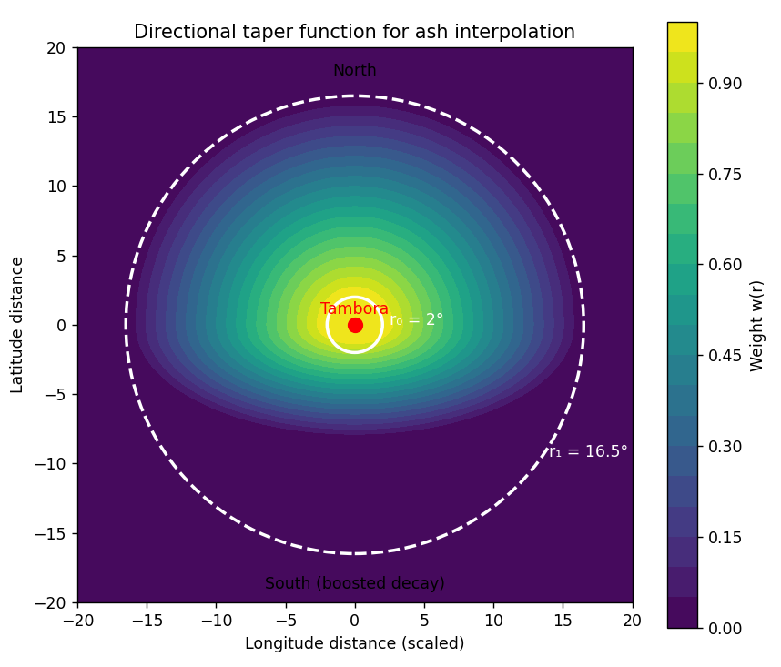
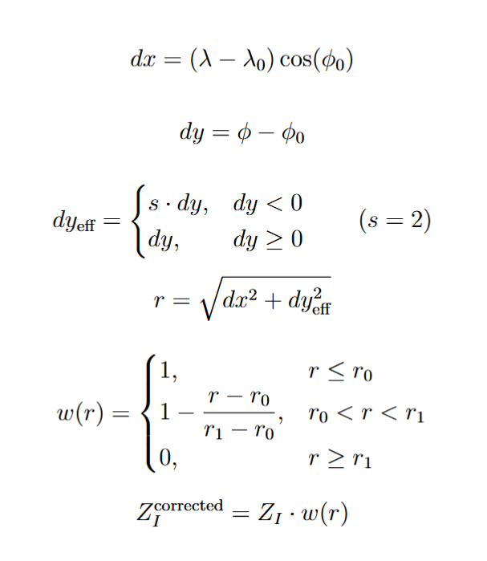

Taper weighting function
Mathematical formulation:
Concept:
Ash thickness is smoothly reduced as a function of distance from the eruption centre.
Let:
$\left(λ_{0} , φ_{0}\right)$= Tambora coordinates
(λ, ϕ) = grid point
Taper weighting function:
Interpolated thickness field:
Notes:
Southern attenuation correction (distance-weighted taper function)
Instead of inserting artificial measurement points, a continuous spatial damping function is applied.
Concept
Ash thickness is smoothly reduced as a function of distance from the eruption center.
Key properties:
Full interpolation strength near Tambora
Gradual attenuation with distance
Directionally asymmetric (stronger decay southward)
Hard cutoff beyond maximum radius Mathematical formulation:
Longitude is latitude-scaled: dx Latitude distance:: dy Southward distances are amplified: dy_eff with south-boost factor: (variable)
Effective radial distance: r Parameters used:
Inner radius: $r_{0}=2^{∘}$
Outer cutoff: $r_{1}={16.5}^{∘}$
The interpolated thickness field $Z_{I}$is weighted by:
Thus:
No modification near the volcano
Smooth decay in distal regions
Zero ash thickness beyond cutoff

Slide 6
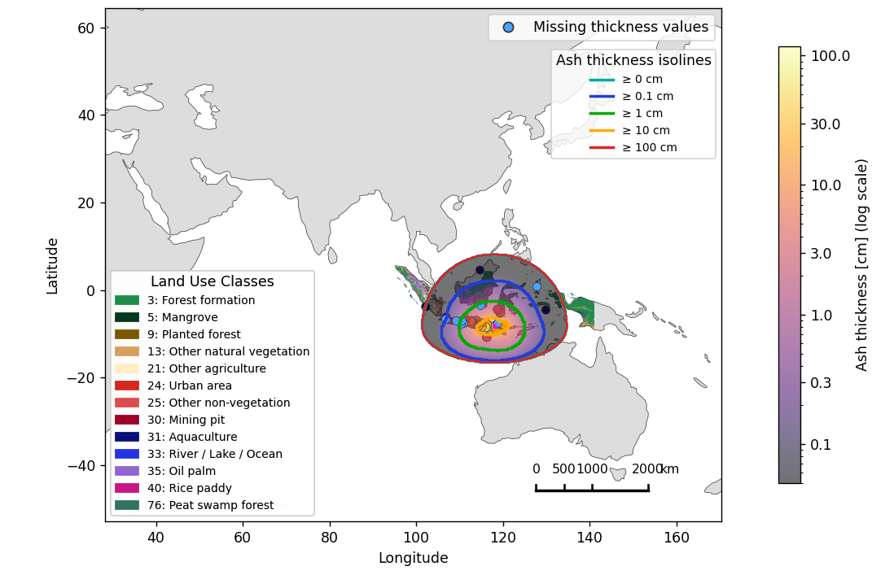
Result: Ash Fall Distribution Map
Method
Land area & ashfall extent (polygon intersection)
Transport Processes
Proximal fallout (heavy, local)
Distal fallout (fine, long-range)
Wind-driven plume transport
Maritime redistribution
Scope & Limitation
Land areas only
Marine ashfall excluded
Ocean impacts not assessed
Our Map
Notes:
Left side
Map showing the full spatial extent of the ash fall
Thresholds defined at 0.1, 1, 10, and 100 cm
The affected area increases as ash thickness decreases
Right side
Map created using a Python workflow
Spatial extents determined via polygon intersection (see next slide)
Besides the natural distribution — typically distinguishing proximal and distal fallout — additional environmental processes influence ash dispersal:
Proximal fallout: Heavy tephra deposition close to Tambora; strong local impact but limited spatial reach
Distal fallout: Fine ash transported over long distances; large geographic footprint but typically lower thickness
Wind direction: Prevailing winds steer the ash plume and explain the asymmetric spatial pattern
Maritime transport: Ash can be redistributed over oceans and coastlines (secondary pathways), contributing to regional spread
Important limitation (scope of this statistic)
Marine ashfall is excluded from the country statistics (land-only intersection)
Consequently, ocean impacts — such as shipping disruption, marine ecosystem effects, and coastal deposition processes — are not covered
It should be noted that a large fraction of the ash most likely fell into the ocean and may have caused substantial environmental damage there
This is primarily due to Indonesia’s geography as an archipelagic island state

Slide 7
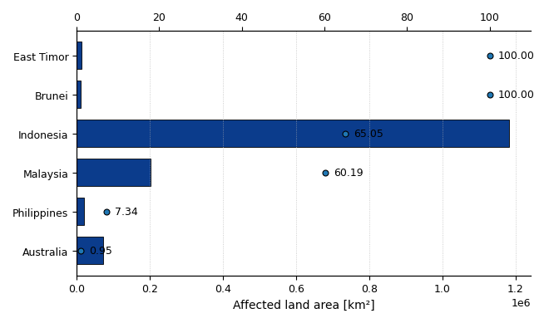
Ash Fall: Affected Countries
Threshold dependence
≥ 1 cm: impact confined to Indonesia
Regional concentration of ash fall
> 80 % lies within Indonesia
> 95 % total ash volume was deposited in Indonesia
Neighboring Countries minor ash fall
Little direct damage from ash fall itself
Direct ashfall overlap; Threshold ≥ 0.0 cm
[%]
https://www.researchgate.net/publication/233720521_Climatic_environmental_and_human_consequences_of_the_largest_known_historic_eruption_Tambora_volcano_Indonesia_1815
Notes:
Regional concentration of ash fall
80% of the affected land area lies within Indonesia (ash fall highly localized)
95% of the total ash volume was deposited in Indonesia
Despite a wide geographic reach, severe ash fall remained spatially concentrated
Threshold dependence
≥ 1 cm: impacts largely confined to Indonesia
These regions were therefore the primary areas affected
Neighboring countries
Brunei and East Timor experienced only minor ash fall
However, local crop failures were reported
Climate anomalies in the following year caused more severe damage
The same applies to Malaysia:
Large spatial exposure
But little direct damage from ash fall itself
Australia
No official ash measurements were conducted
However, reports describe:
Darkened skies
Fine ash / atmospheric haze transported over long distances
Global consequences
Strongest impacts in the Southern Hemisphere
Nevertheless, global cooling occurred
Led to severe harvest failures worldwide
Up to ~100,000 deaths have been attributed to the aftermath
Uncertainty & attribution
Direct attribution is difficult
Multiple concurrent factors may have contributed
e.g., crop diseases such as potato blight

Slide 8
Reminder on Indonesia
Agriculture: acid damages, discolouration, …
Humans & livestock: little damage (e.g. irritation)
→ Soluble salt burden, particle size, abrasiveness
Kalimantan
Sulawesi
284M+ people across all islands
Ash-fall
Below 10 cm
Area:
Indonesia 645854 km²
Malaysia 21794 km²
Sumatra
Tambora
Agriculture: acidic leachate, weight, shading, …
Humans & livestock: similar symptoms more severe
→ Soluble salt burden, mechanical strength, …
(2) Ash fall of 1 cm up to 10 cm:
Damage to livestock is similar to less ash fall but generally more severe.
Access to clean drinking water and food is likely impaired and nutrient supplements necessary.
Ingestion of much Arsch likely leads to intestinal blockages and fluorosis is more likely.
Plants and agriculture may suffer from the ashes weight and shading of the sun.
Acidic leachate likely damages fruit and foliage.
The impact on agriculture potentially leads to food shortages for humans in surrounding areas.
Key quantities are soluble salt burden and mechanical strength of the ash layer.
(3) Ash fall above 10 cm and up to 100 cm:
Generally a stronger incapitation of human society and appearance of more severe long term effects.
Agriculture suffers severely from heavy loads of ash.
Planted crops are lost and new ones cannot be sown due to the soil being buried below the thick layers of ash.
Rehab of soil by human intervention is likely necessary.
Therefore humans are bound to face food shortages.
Trees are damaged by the load and shading from the sun.
Key quantities are density, loading, particle size and thickness of the ash cover.
(4) Ash fall Above 100 cm:
Total burial of basically anything.
Life in this region is hardly possible without MAJOR efforts to remove the ash cover and restoration of soil and environment.
(5) Conclusion and global effects:
Overall one may expect 100s of millions of dollars in "economical" damages besides thousands of casualties.
Java
Nusa Tenggara Barat
→ The people of Indonesia are terribly fucked
Bali

Slide 9
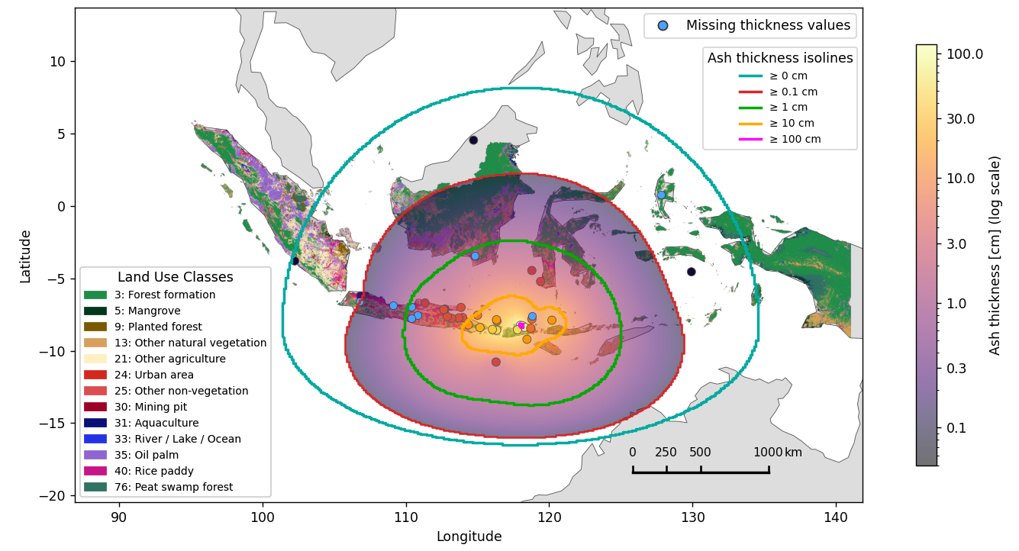

Damage Assessment I
Affected regions: East Sumatra, Java, Kalimantan, Sulawesi, Bali, Nusa Tenggara Barat and more (near 1.102M $km^{2}$ ~ 58 % landmass)
Agriculture: acid damages, discolouration, …
Humans & livestock: little damage (e.g. irritation)
→ Soluble salt burden, particle size, abrasiveness
Possible and likely harm:
Irritation of skin & eyes
Contamination of drinking water and food supplies
Acidic soil & seep dama-ges plants, fruit, foliage
Discouloration, shading, weight damage to plants
Medium shortages likely
Ash-fall
Below 10 cm
0.01 up to 10 cm
Area:
Indonesia 645854 km²
Malaysia 21794 km²
Agriculture: acidic leachate, weight, shading, …
Humans & livestock: similar symptoms more severe
→ Soluble salt burden, mechanical strength, …
(2) Ash fall of 1 cm up to 10 cm:
Damage to livestock is similar to less ash fall but generally more severe.
Access to clean drinking water and food is likely impaired and nutrient supplements necessary.
Ingestion of much Arsch likely leads to intestinal blockages and fluorosis is more likely.
Plants and agriculture may suffer from the ashes weight and shading of the sun.
Acidic leachate likely damages fruit and foliage.
The impact on agriculture potentially leads to food shortages for humans in surrounding areas.
Key quantities are soluble salt burden and mechanical strength of the ash layer.
(3) Ash fall above 10 cm and up to 100 cm:
Generally a stronger incapitation of human society and appearance of more severe long term effects.
Agriculture suffers severely from heavy loads of ash.
Planted crops are lost and new ones cannot be sown due to the soil being buried below the thick layers of ash.
Rehab of soil by human intervention is likely necessary.
Therefore humans are bound to face food shortages.
Trees are damaged by the load and shading from the sun.
Key quantities are density, loading, particle size and thickness of the ash cover.
(4) Ash fall Above 100 cm:
Total burial of basically anything.
Life in this region is hardly possible without MAJOR efforts to remove the ash cover and restoration of soil and environment.
(5) Conclusion and global effects:
Overall one may expect 100s of millions of dollars in "economical" damages besides thousands of casualties.
→ The people of Indonesia are terribly fucked

Slide 10
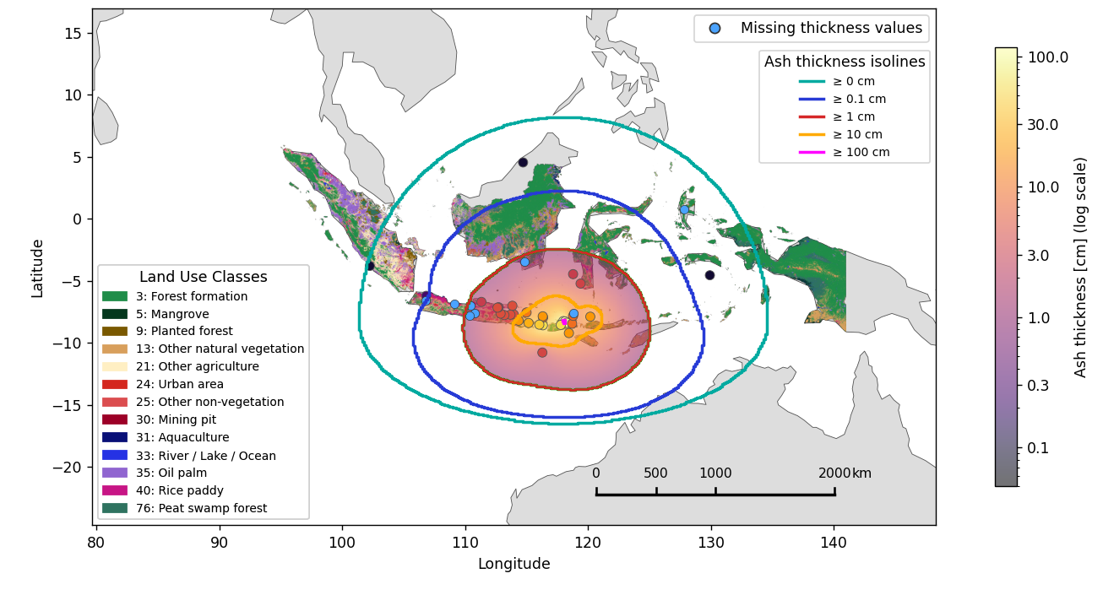
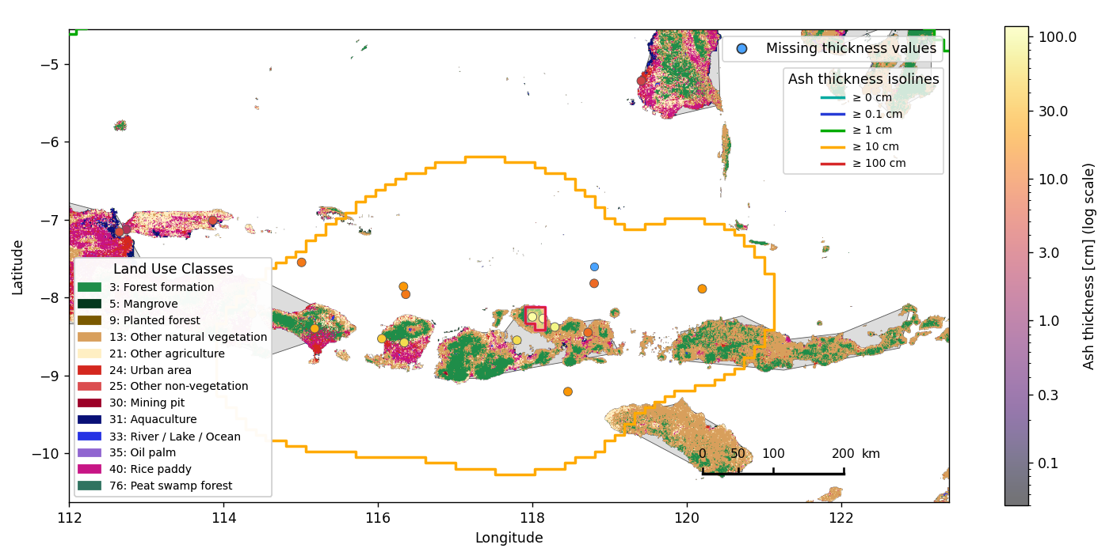

Damage Assessment II
Affected regions: East Java, Bali and Nusa Teng-gara Barat (near 123K $km^{2}$ ~ 6.5 % landmass)
Ash-fall
Below 1 cm
Possible and likely harm:
Collapse of simple roofing
Harvest of goods and sowing crops impossible
Large shortages in food and drinking water supply
Cancellation of nearly all tourism programs on Bali
10 cm and more
Area:
Indonesia 1.085776e+06km²
Malaysia 1.454705e+05km²
East Timor 1.471082e+04km²
Brunei 4.745231e+03km²
Agriculture: acidic leachate, weight, shading, …
Humans & livestock: similar symptoms more severe
→ Soluble salt burden, mechanical strength, thickness
Agriculture: acid damages, discolouration, …
Humans & livestock: little damage (e.g. irritation)
→ Soluble salt burden, particle size, abrasiveness
→ The people of Indonesia are terribly fucked

Slide 11
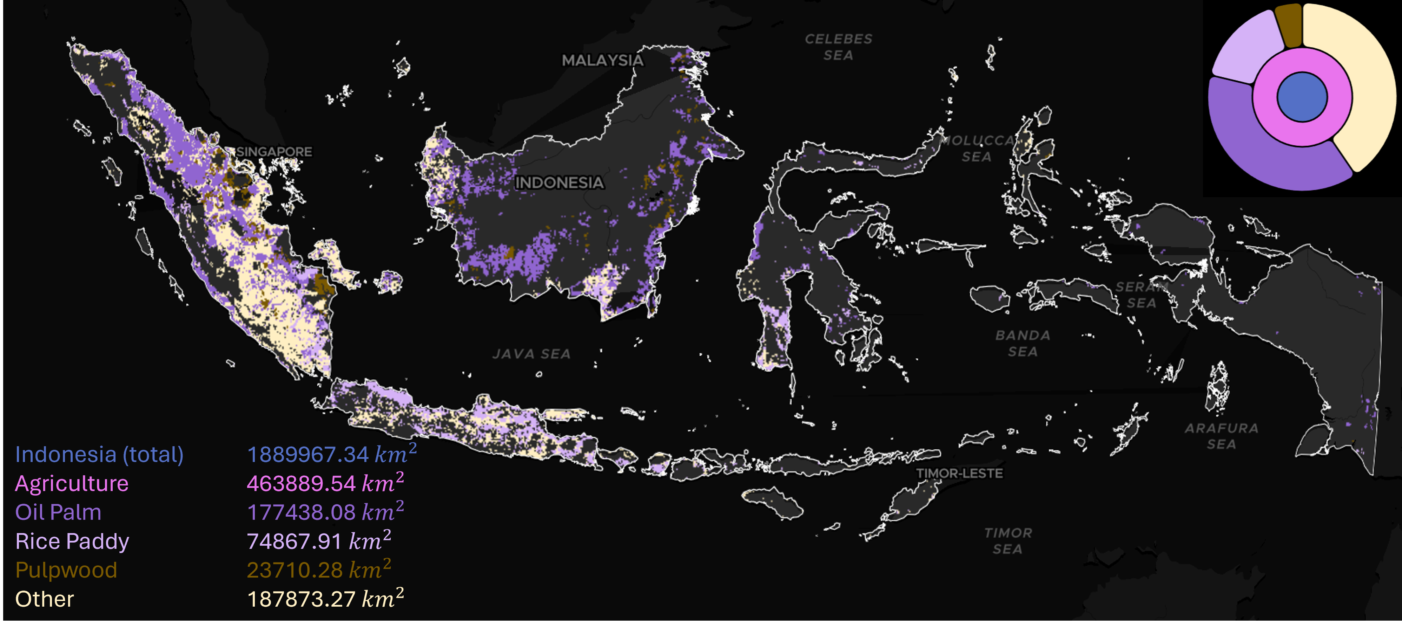
Analysis on Agricultural Impact I
Indonesia‘s agriculture features palm oil, rubber, rice, corn, coffee and cocoa, spices and more…
In 2025 Indonesia reached fully self-sufficient supply on rice and corn
Exports of fresh and processed agricultural goods made up approximately 16 % of Indonesia's export revenue

Slide 12
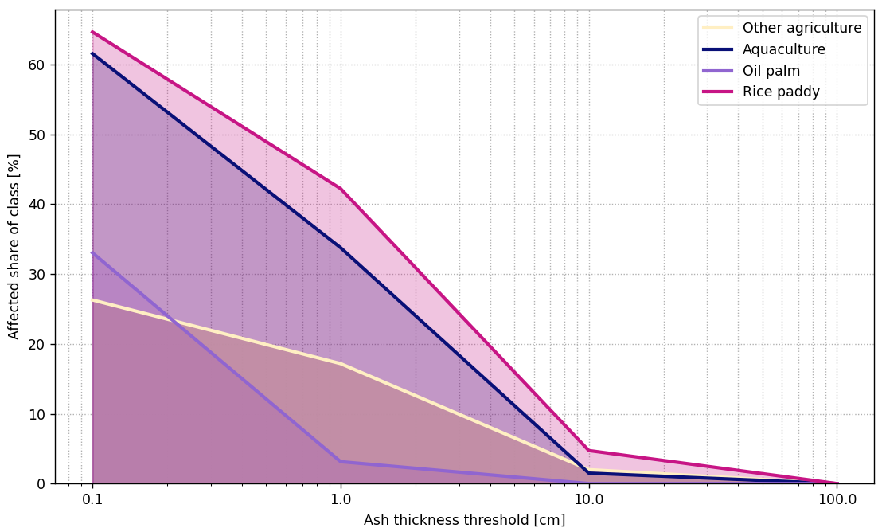
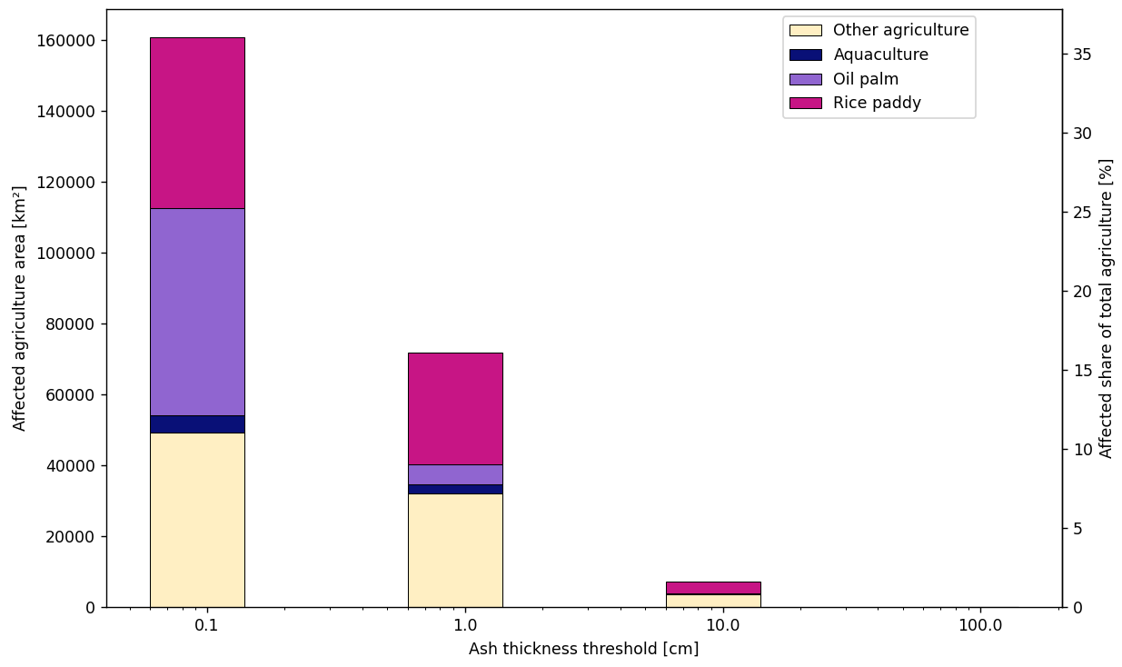
Analysis on Agricultural Impact II
27 %
12 %
2.5 %
Rice paddies struck especially leading to large food supply issues
Fishing industry likely to face issues as well
Vital hit on Indonesia’s agriculture
Notes:
Agricultural exposure
Approximately two-thirds of Indonesia were affected by ash fall
However, only about one-third of this area is agricultural land
Nevertheless, long-term impacts are still observable
Damage severity
Direct agricultural damage from ash fall alone is lower than often assumed
Only about 3–4% is definitively destroyed
Up to 15% faces a very high risk of severe damage
The remaining ~20% is exposed to only low risk
Most affected crop types
Particularly vulnerable:
Rice paddies
Oil palm plantations
Other agricultural sectors
Remaining agriculture mainly consists of:
Maize
Cocoa
Coffee
Peanuts
Tea
Soybeans
Other mixed crops

Slide 13


The Indonesian Economy
2025 export revenue $ 283B
Share of agricultural goods between 15 to 18 %
Largest national economy in the ASEAN region with near $ 1.5T GDP
Agriculture, forestation & fishing industry about 13.5 % of the GDP
Java alone contributes about 17 % of the GDP
Foreign exchange revenue (FER) in tourism about $ 19B
Bali has near 50 % FER (~ $ 9B) with 15.4M tourists in 2025
No volcano eruption
Tambora eruption

Slide 14
Impacts on the World Market
world leader market revenue share for palm oil with 31.1 %
2nd largest exporter of rubber with ~ 20 % market revenue share
3rd largest producer of cocoa products (~ $ 2.6B)
Contributing 5 % world coffee exports (~ $ 1.5B)
(Major) shortages on world market & (monumental) price surges facing industry and consumers worldwide
No volcano eruption
Tambora eruption

Slide 15
Literature
J. Kandlbauer, R.S.J. Sparks / Journal of Volcanology and Geothermal Research 286 (2014) 93–100; http://dx.doi.org/10.1016/j.jvolgeores.2014.08.020
Jenkins, S.F., Wilson, T.M., Magill, C.R., Miller, V., Stewart, C., Marzocchi, W. and Boulton, M., 2015. Volcanic ash fall hazard and risk: Technical Background Paper for the UNISDR 2015 Global Assessment Report on Disaster Risk Reduction. Global Volcano Model and IAVCEI; www.preventionweb.net/english/hyogo/gar
Brönnimann S, Krämer D. 2016. Tambora und das «Jahr ohne Sommer» 1816. Klima, Mensch und Gesellschaft. Geographica Bernensia G90, 48 S., doi:10.4480/GB2016.G90.02. ISBN: 978-3-905835-45-8

Slide 16
Author Contribution Statement
Python Code: J. Schulte
Plots & Images: J. Schulte, A. Vitantzakis
Code Review: J. Schulte, A. Vitantzakis
Reference Material: J. Schulte, A. Vitantzakis
Presentation Slides: A. Vitantzakis & J. Schulte (con. eq.)
Sourcing Map: A. Vitantzakis, J. Schulte
Damage Assessments: A. Vitantzakis, J. Schulte
Pamphlet: A. Vitantzakis

Slide 17
Supplement

Slide 18
On the Internal Food Supply

Slide 19
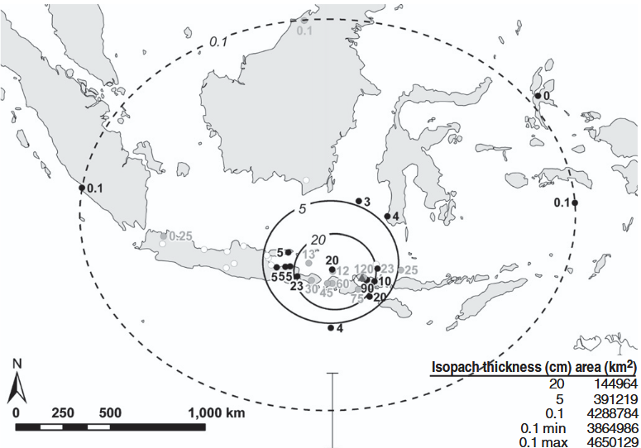
Comparison: Ash Fall Map
J.Kandlbauer, R.S.J.Sparks; Journal of Volcanology and Geothermal Research, 286 (2014) 93–100

Slide 20
Basis of our project
Epicenter Tambora
→ Publication contains all data points of the ash-fall from first-hand sources, e.g. East India Company reports, pseudo first-hand sources like deep sea cores and second-hand sources
Notes:
Left side
Paper by Kandlbauer & Sparks (2014)
Includes volume calculations
Highlights how uncertain the data situation is
Error bars of about ±25%
Data points originate from multiple sources — both historical and modern (1816–2013)
New data points were obtained through recent simulations
Includes both deep-sea and terrestrial deposits
Critical parameters include eruption timing and particle fall velocity
Right side
Map of Indonesia and neighboring regions
Blue dots represent measurement points without specific quantitative values
Map was matched with data from Indonesia MapBiomas
Research initiative (originally from Brazil) focused on climate and environmental monitoring
Scale in the lower right provides a rough impression of the spatial extent

Slide 21
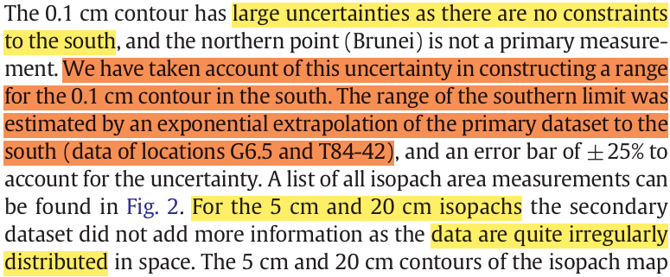
The Dataset and its Issues
→ Publication contains all data points of the ash-fall from first-hand sources, e.g. East India Company reports, pseudo first-hand sources like deep sea cores and second-hand sources
Working with data this sparse?
→ Not fun.
J.Kandlbauer, R.S.J.Sparks; Journal of Volcanology and Geothermal Research, 286 (2014) 93–100

